Slide 1
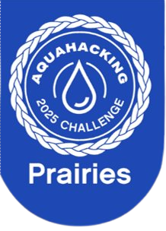

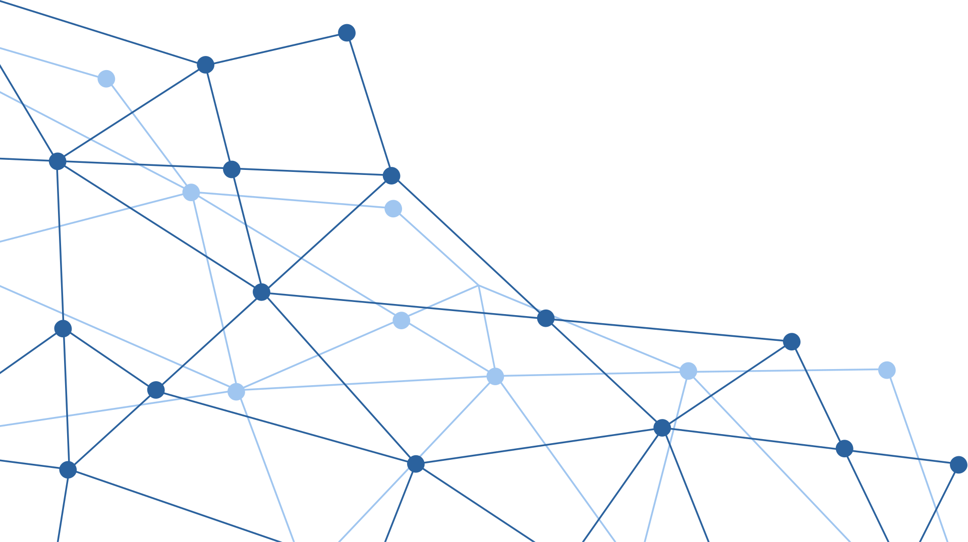
AGUA LINK SOLUTIONS
SMALL SCALE & COMMUNITY DECISION MAKING TOOLS FOR EXTREME WATER EVENTS

Slide 2
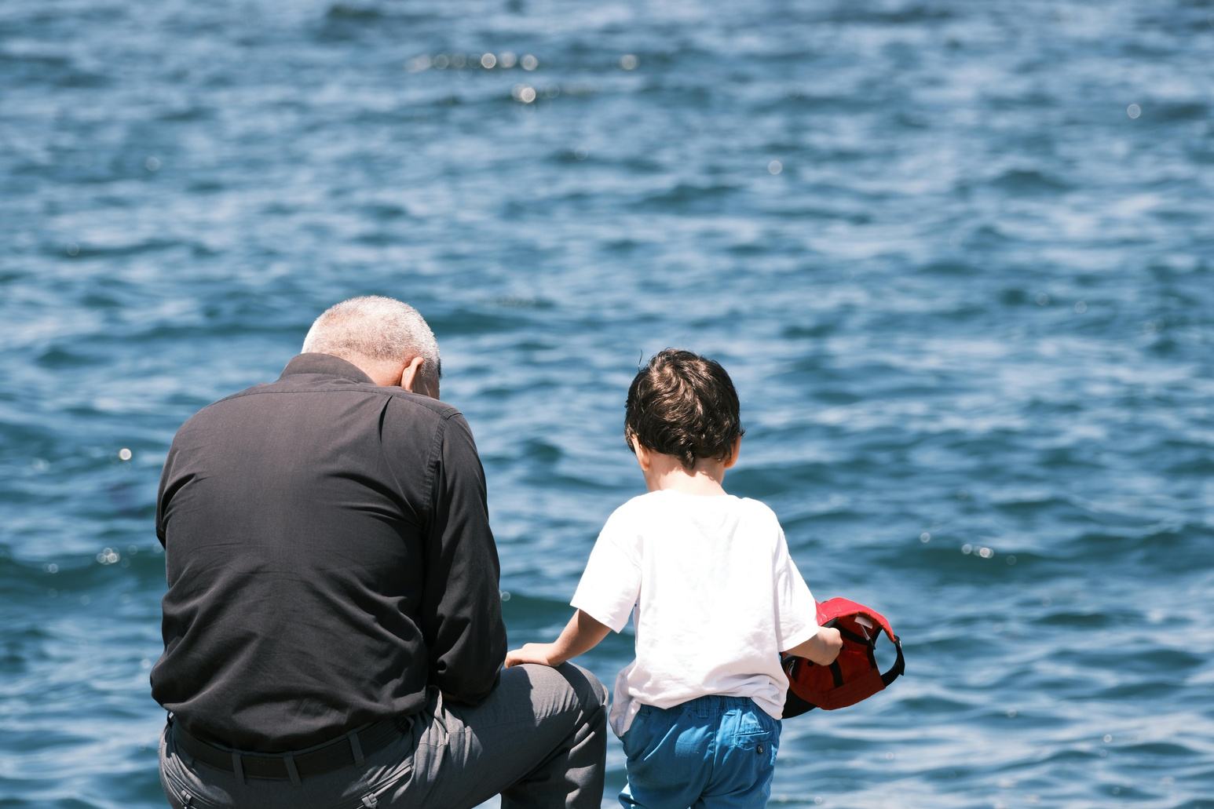
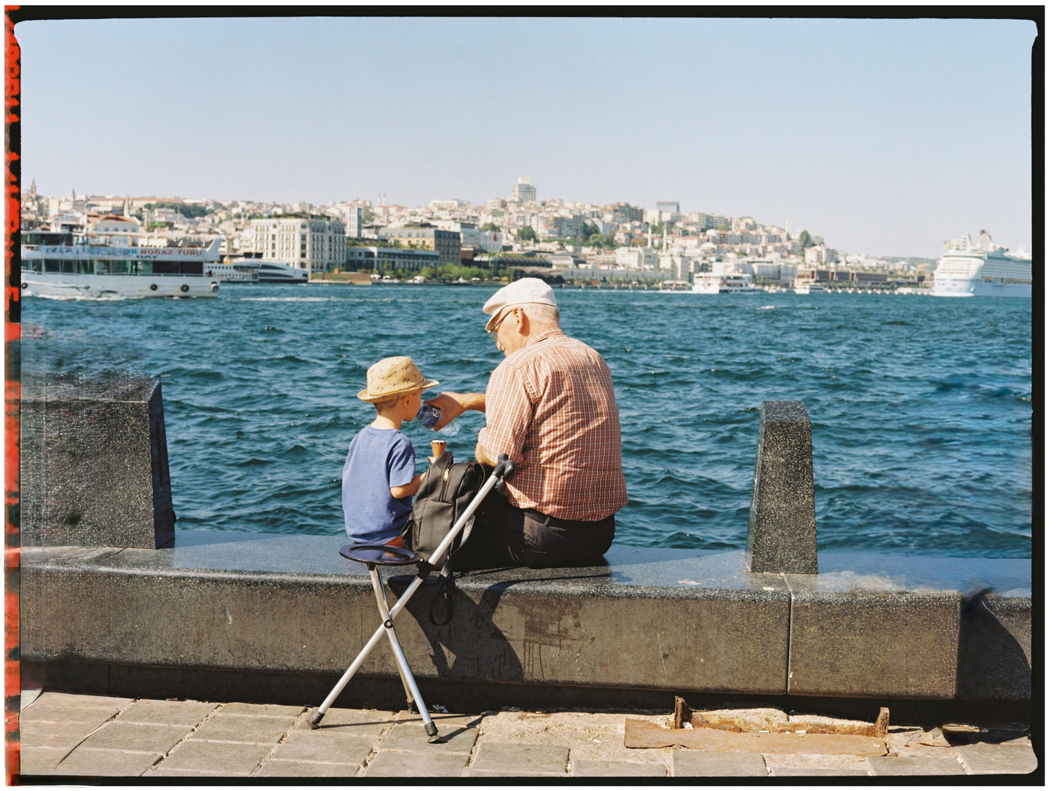
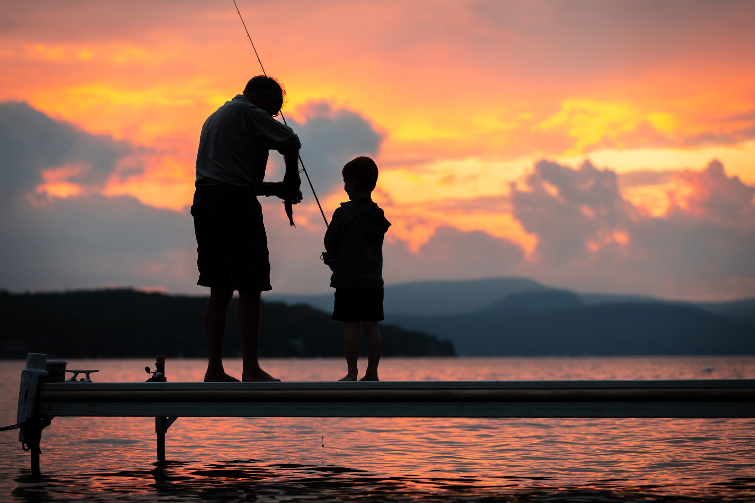
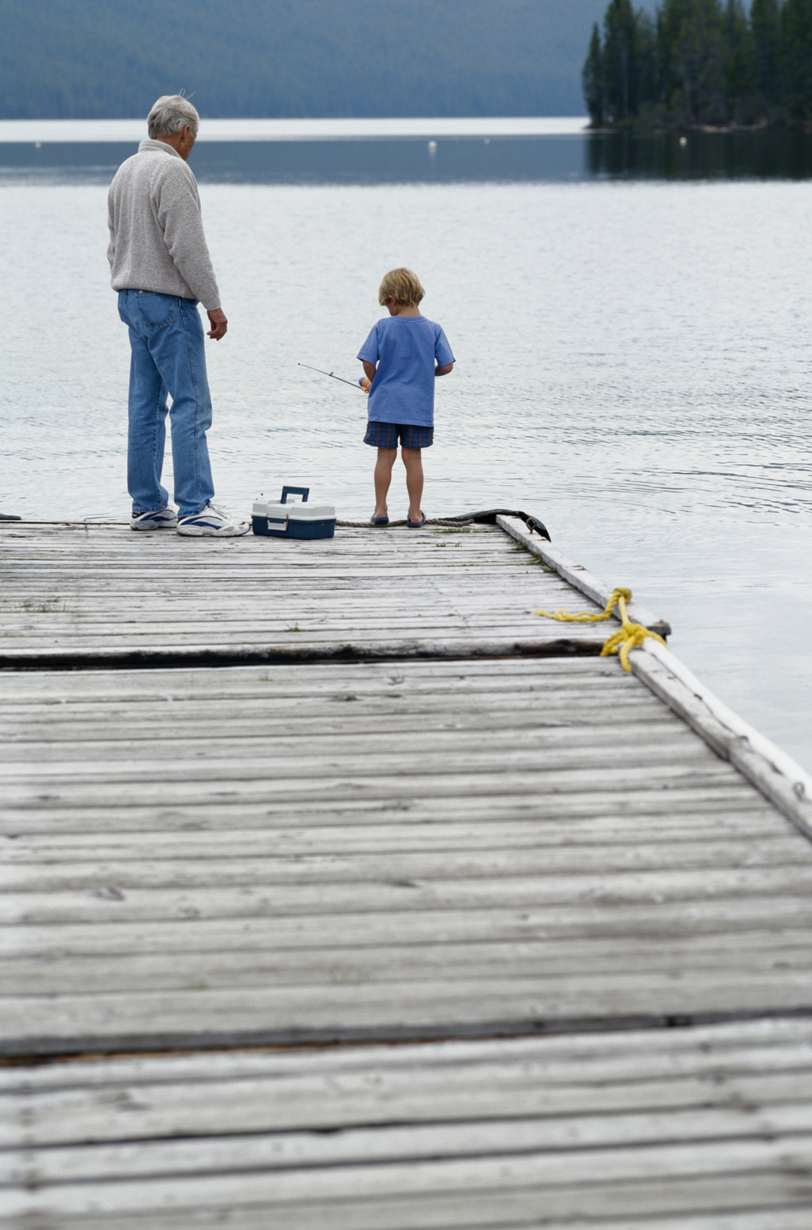
A DIFFERENT KIND OF INHERITANCE

Slide 3
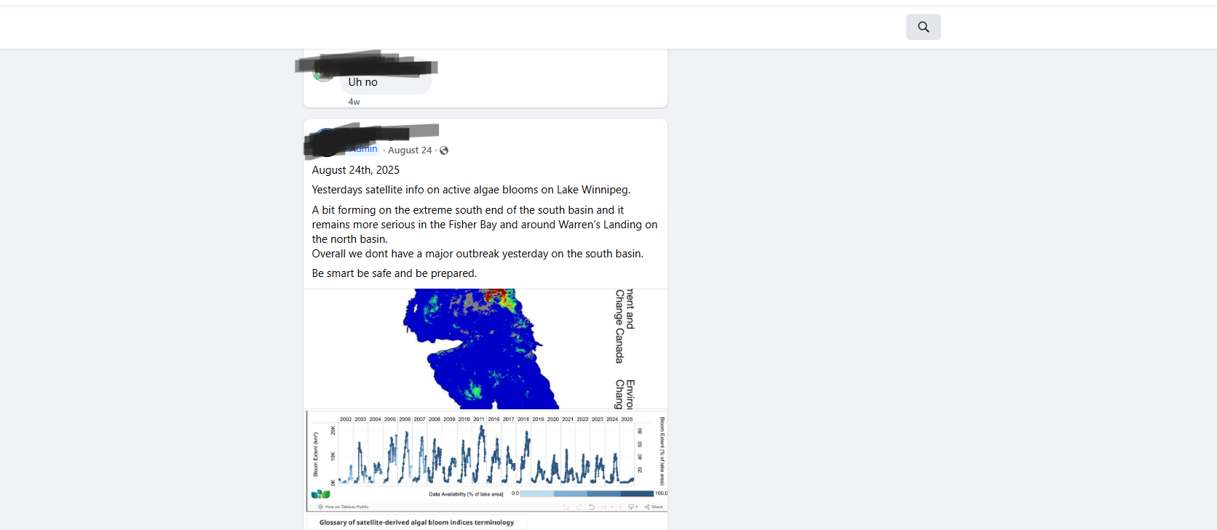
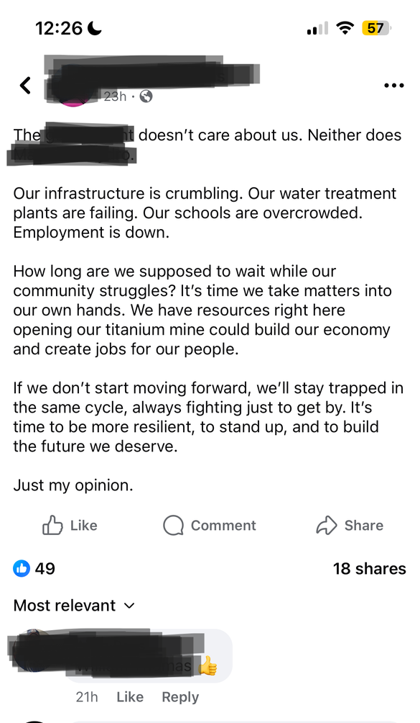
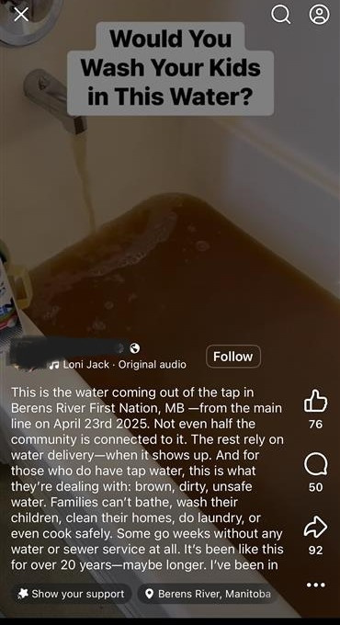
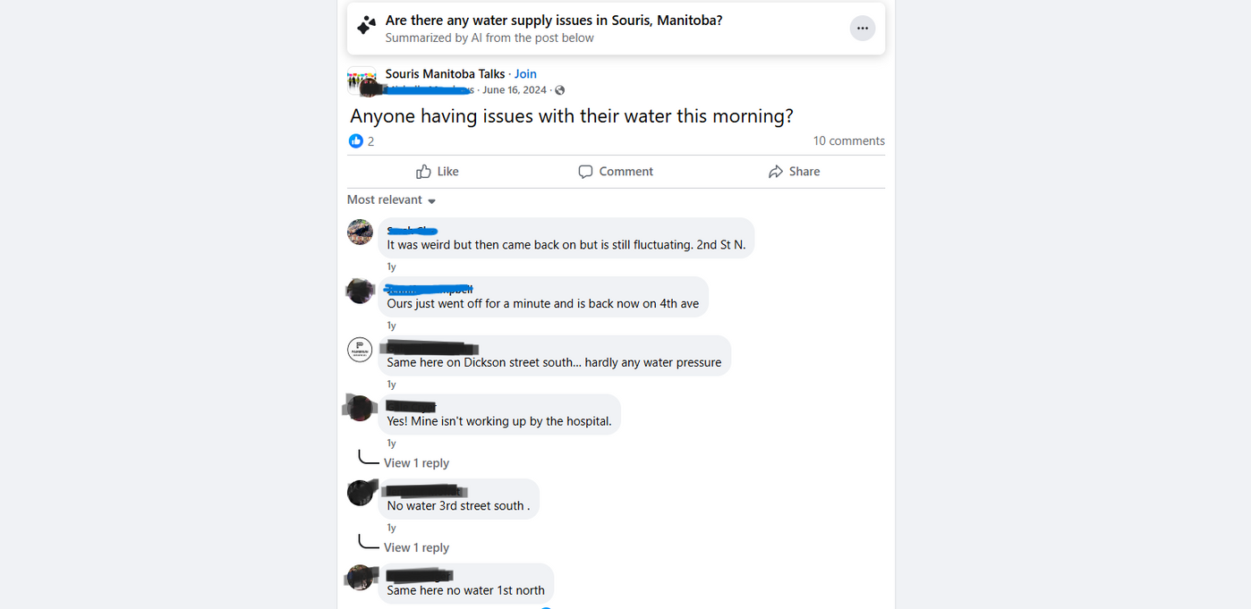
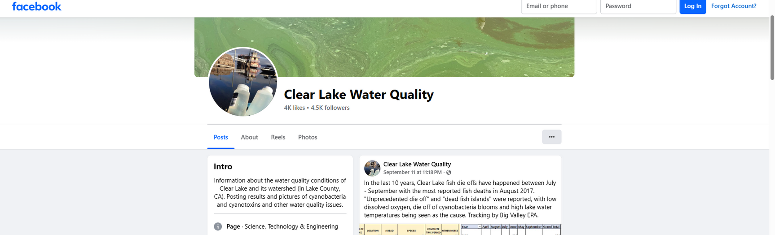
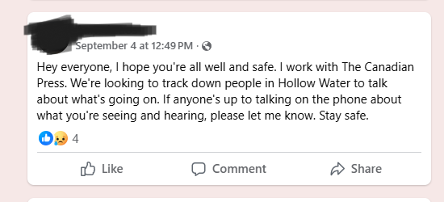
THE PROBLEM: A SYSTEMIC FAILURE OF COMMUNICATION
Generations of local knowledge about the environment are disappearing.
Urgent warnings posted by residents in online groups are frequently missed or overlooked.
A community's warning about a wildfire was ignored by officials, and as a result, homes were destroyed.
There is no single place for this information, forcing news reporters to search through dozens of separate Facebook groups to find local contacts during a crisis.

Slide 4
OUR SOLUTION: A SINGLE, TRUSTED HUB FOR COMMUNITY TRUTH
An application that turns lived experience into undeniable evidence.
Here’s How It Works
Geolocated report with a photo.
The report instantly appears as a pin on a live map.
A built-in chat connecting you with people facing the same issue and others who can help.
Sentiment Analysis: Scans public social media to ensure no concern is left behind.
Accountability Ledger
Saves traditional knowledge for the next generation.

Slide 5
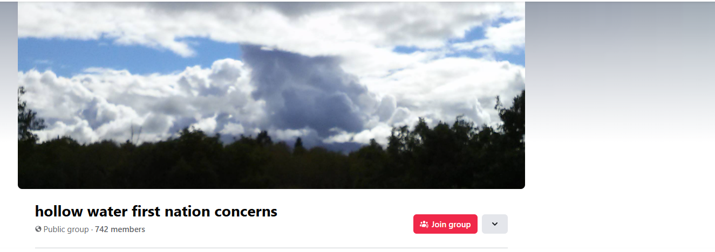
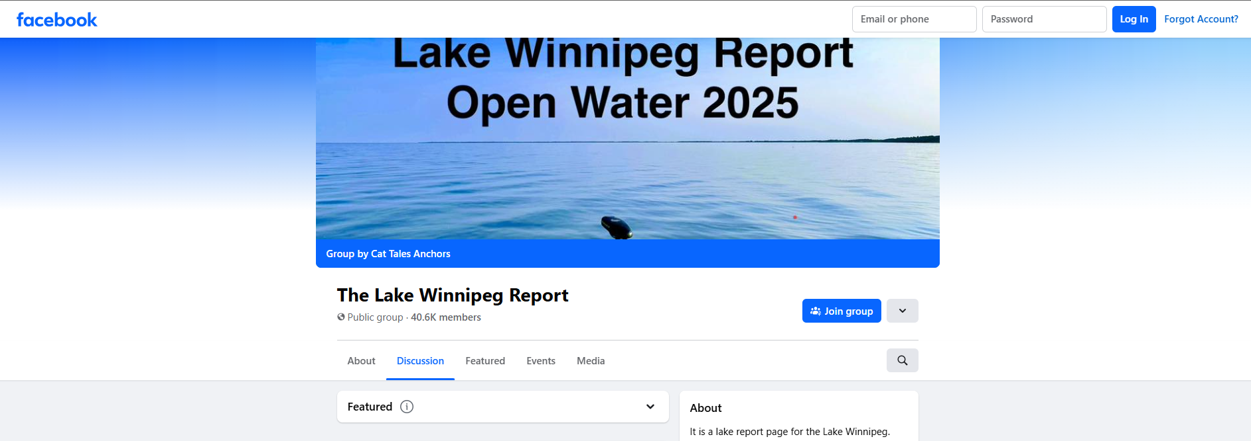

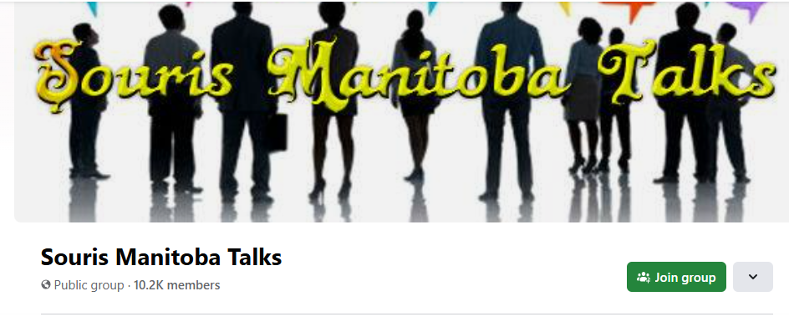
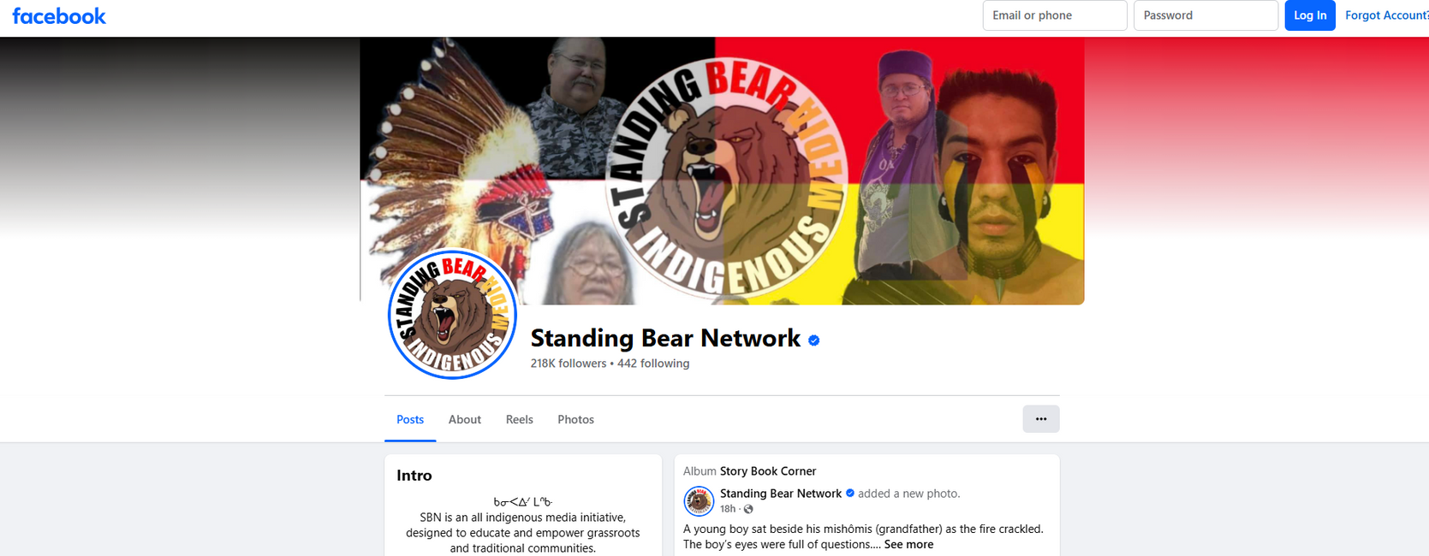
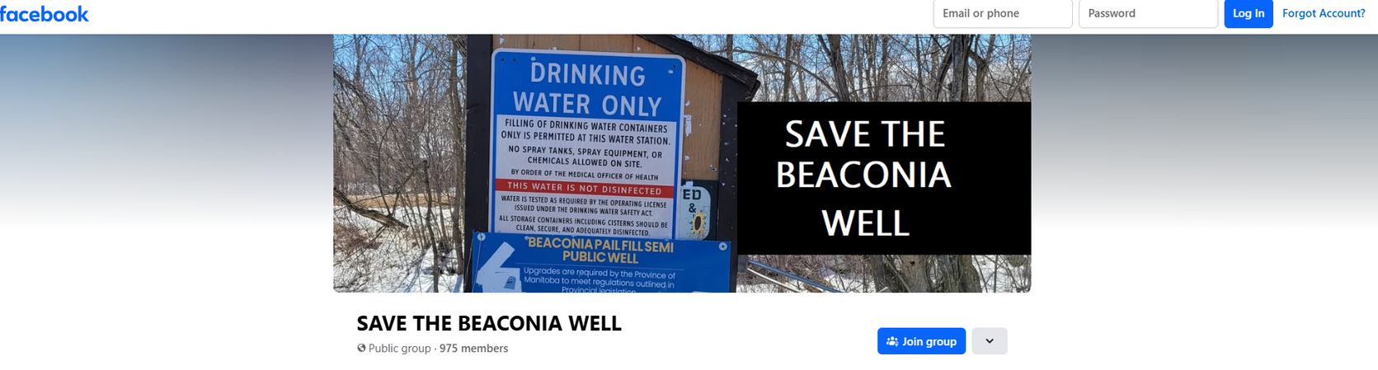
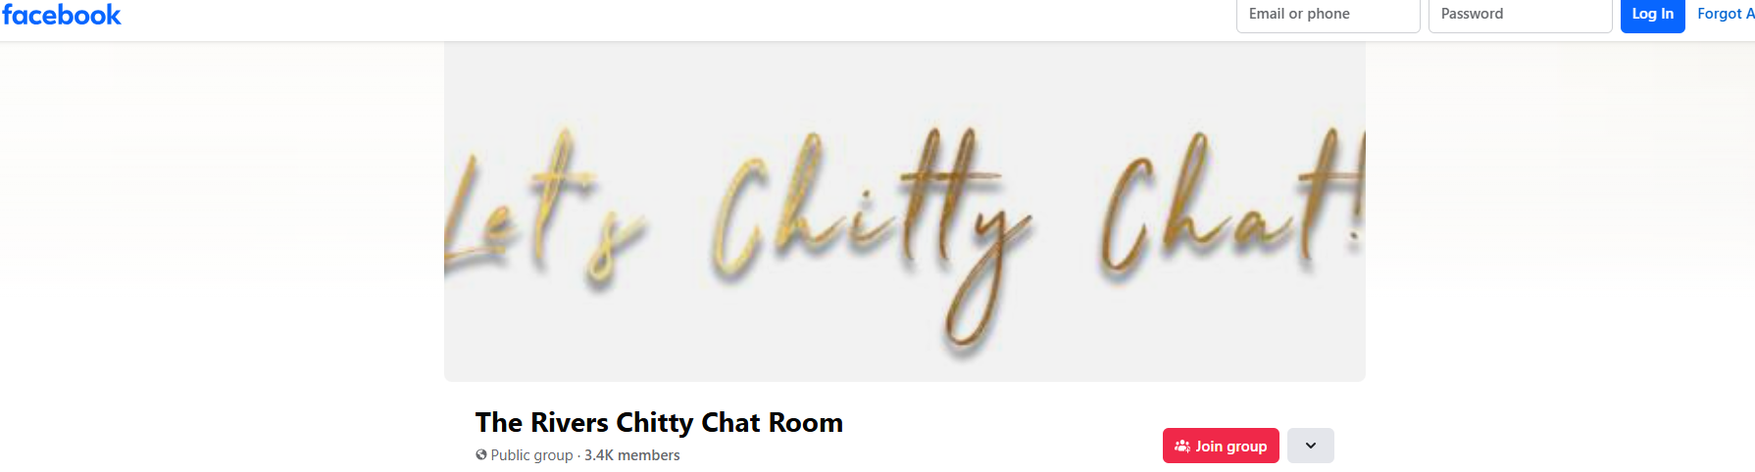
HOW DO WE KNOW THIS WOULD WORK?

Slide 6
OUR BUSINESS MODEL: BRIDGING THE INFORMATION GAP
We provide a roadmap to untapped markets by identifying specific, community-validated needs, de-risking investment and guiding effective expansion.
We are a direct, real-time source of verified, on-the-ground reports, enabling faster and more authentic journalism.
We deliver a live dashboard of community needs for faster, evidence-based decisions and more effective resource allocation.
We offer an ethical channel for primary research, providing access to longitudinal data and a new way to preserve Indigenous Knowledge

Slide 7

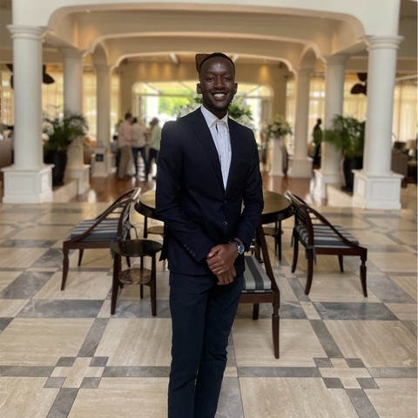
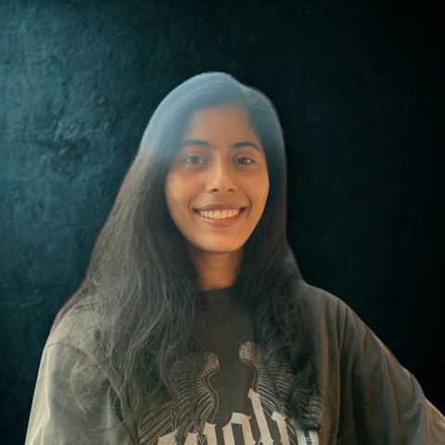

OUR TEAM
Princess Cortes
Alex Juma
Manju Thomas
Sara Riyazi
Economics / Data Science and Machine Learning / Mechatronics
Computer Science / Data Science and Machine Learning
Physics/ Data Science and Machine Learning
Biochemistry

Slide 8
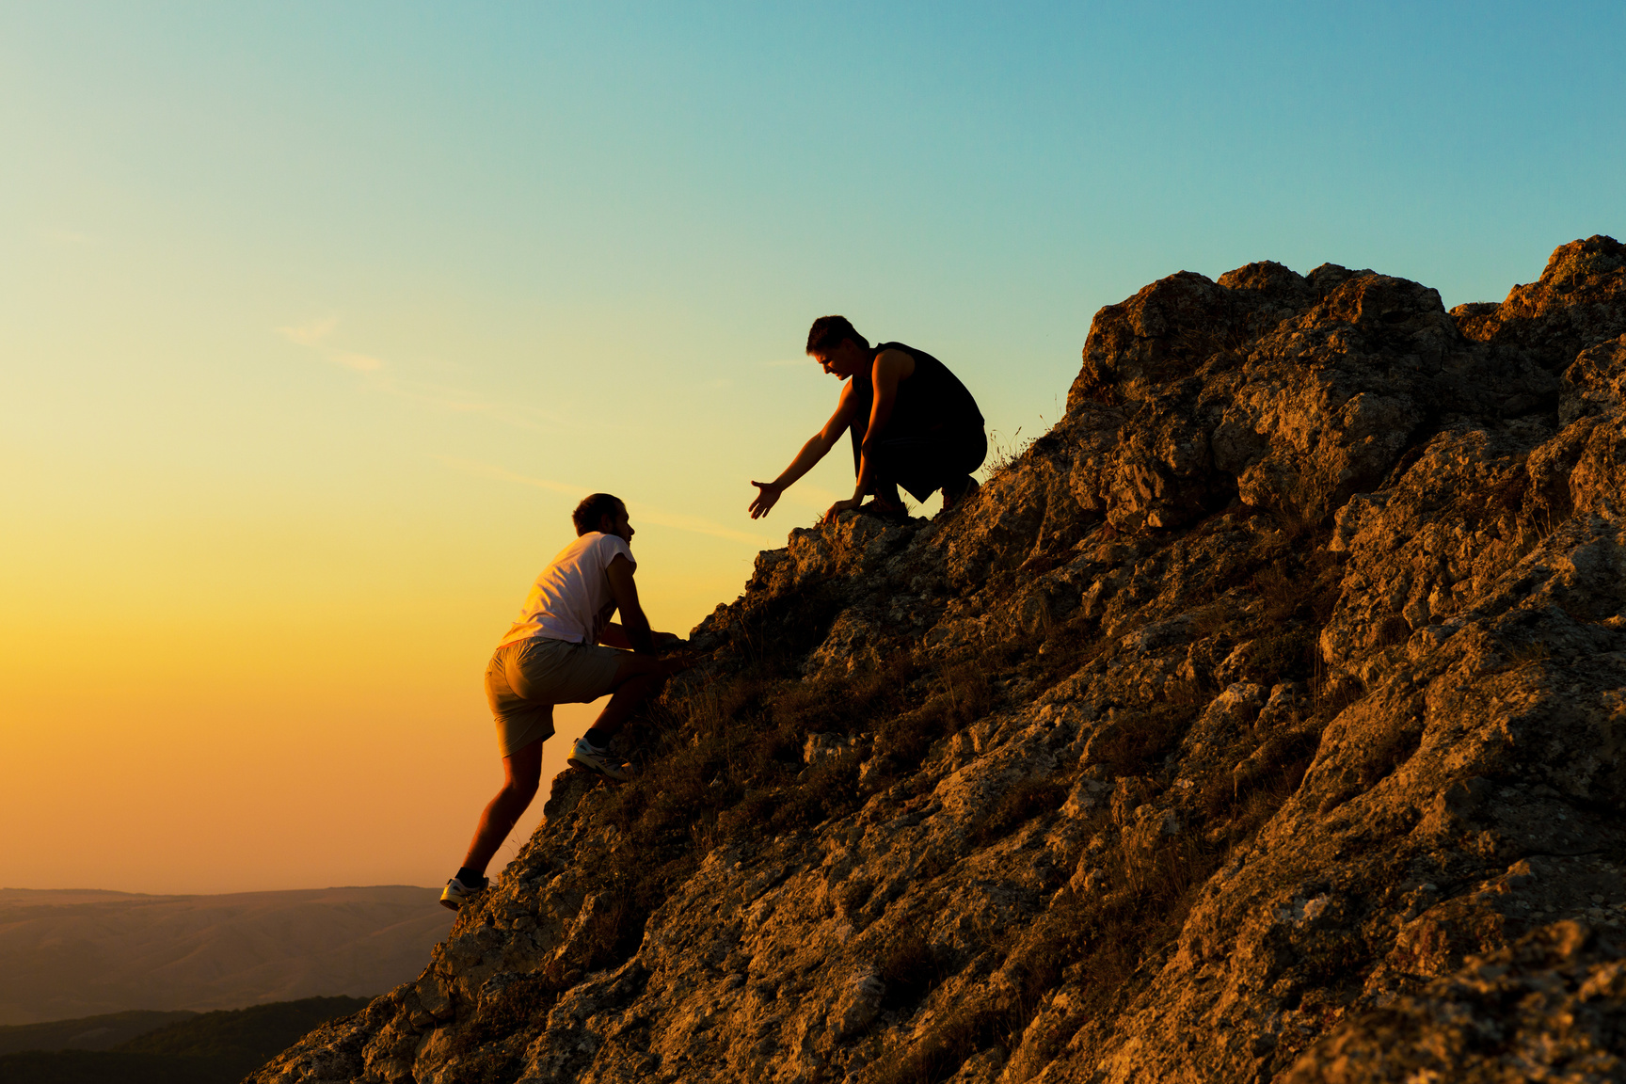
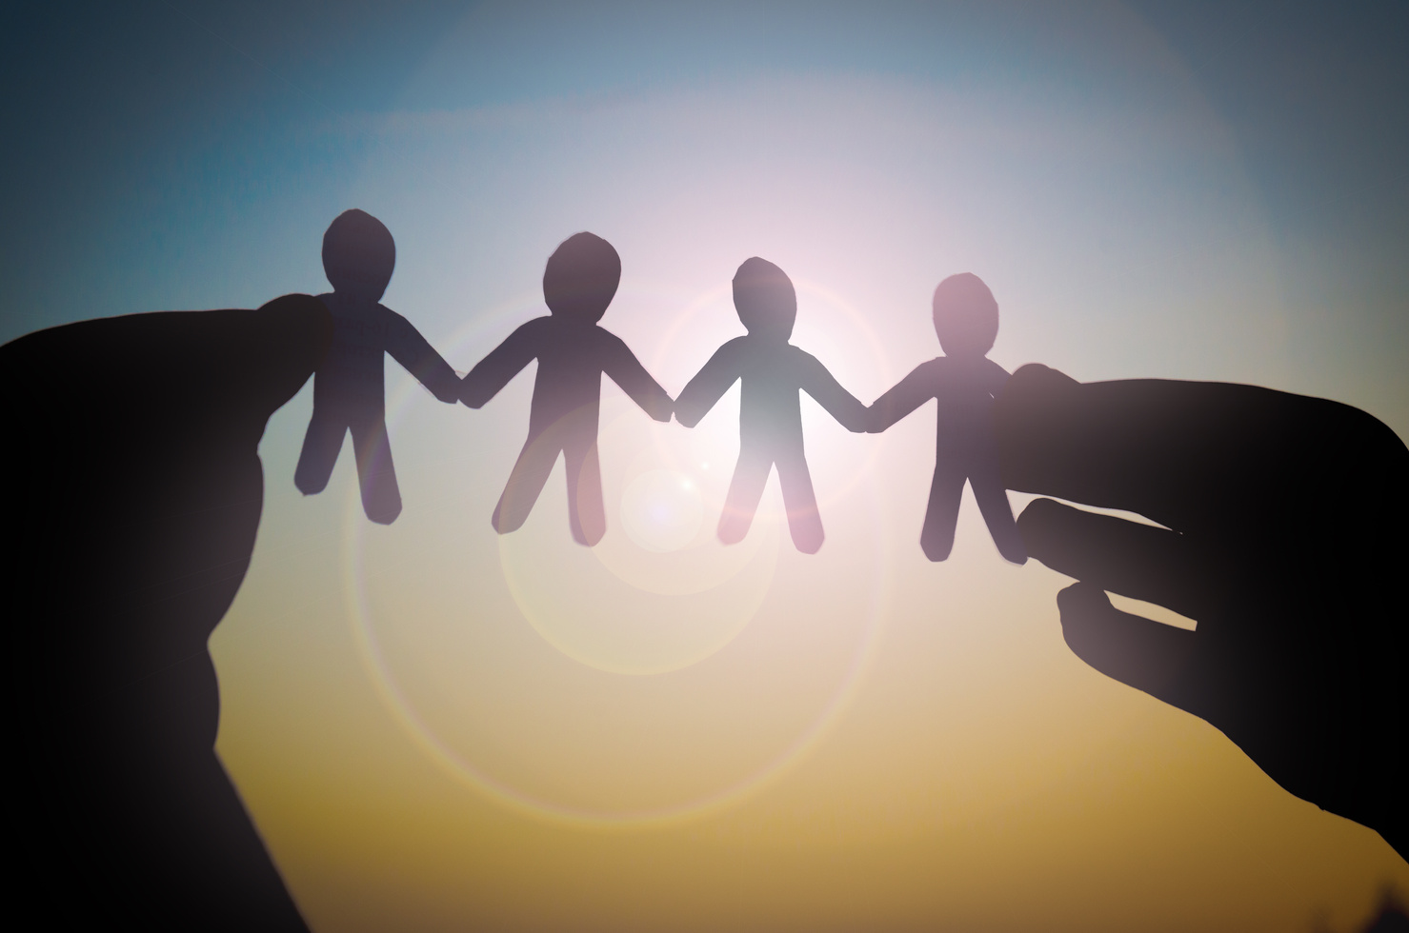
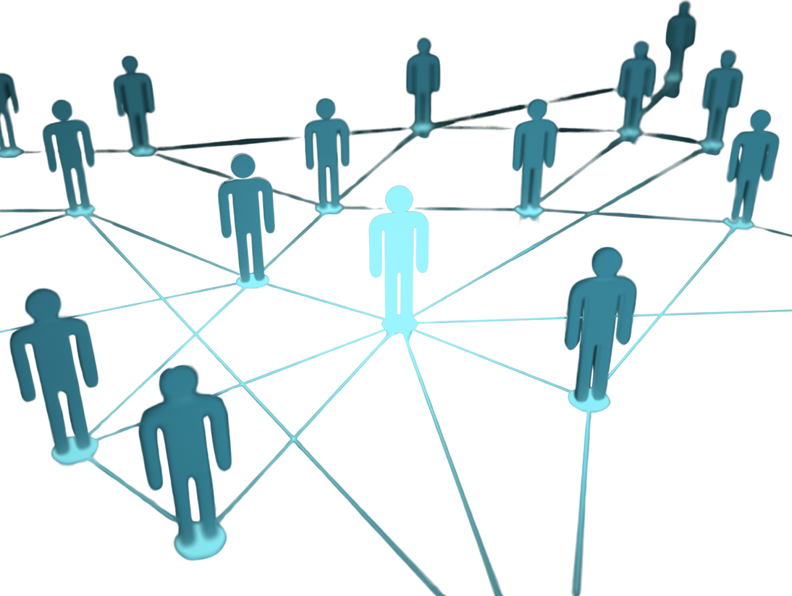
THE TIME IS NOW

Slide 9
THANK YOU

